Slide 1
PoMo – POlymorphism-aware phylogenetic MOdel
Phylo Seminar 2024
Bhagya Amarasinghe

Slide 2
ILS
Causing incongruencies of the overall species-level tree.

Slide 3
PoMo
Genome-wide species tree estimation
Simple maximum likelihood approach
Allele frequency based
Accounts for ancestral variation and ILS
Effectively estimate mutation rates and fixation biases

Slide 4
Past work – other likelihood-based methods
Population tree
Assume polymorphism observed within or between taxa already existed at the root/ no new mutations
Two alleles per site
All sites are unlinked
Species tree
Infinite sites
Any number of alleles
Sites from the same locus are linked

Slide 5
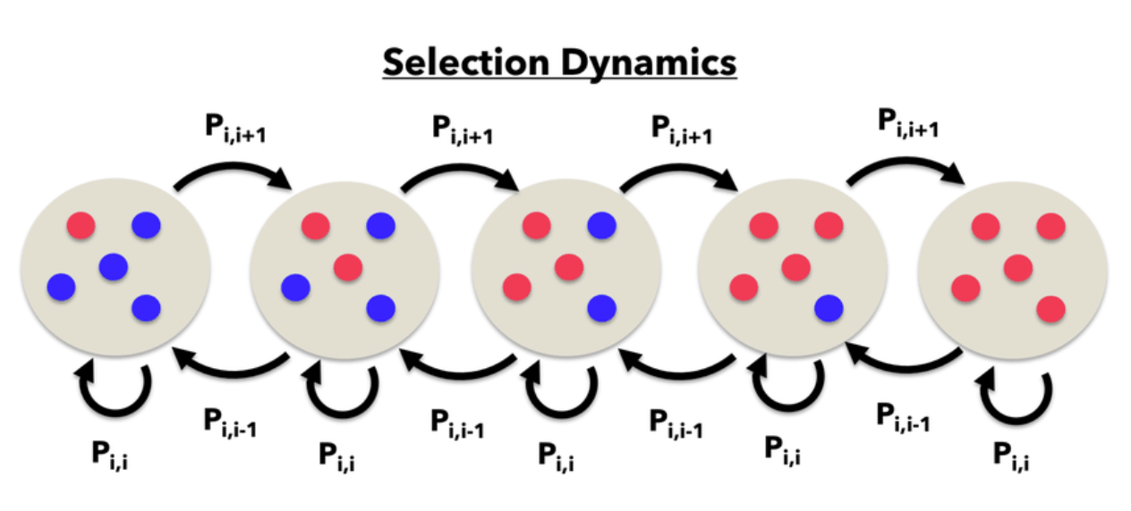
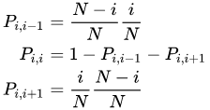
Method
Moran Model of genetic drift - a single allele copy dies and another reproduces in each time step. Maintains a constant population size of N

Slide 6
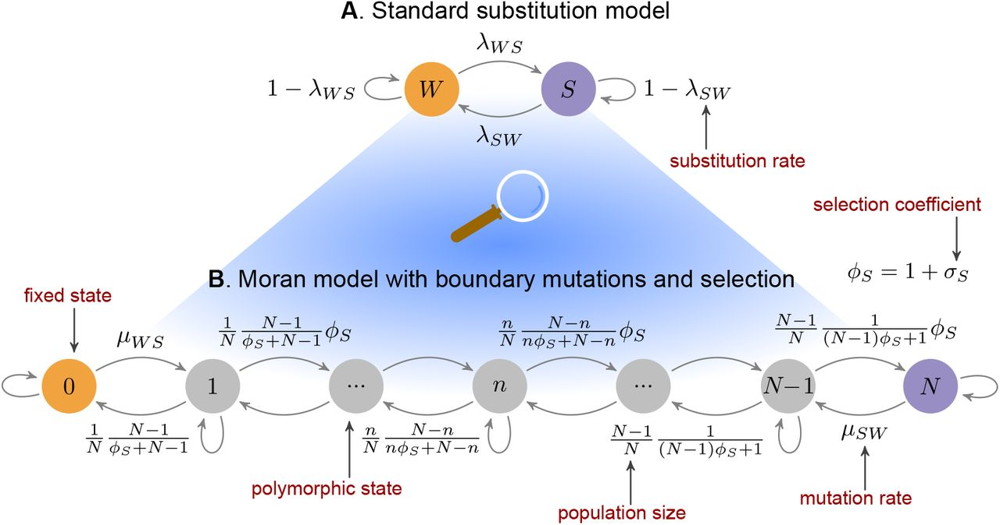
Hasegawa–Kishono–Yano (HKY) model of mutation - which assume that nucleotides occur at different frequencies, and that transitions and transversions occur at different rates

Slide 7
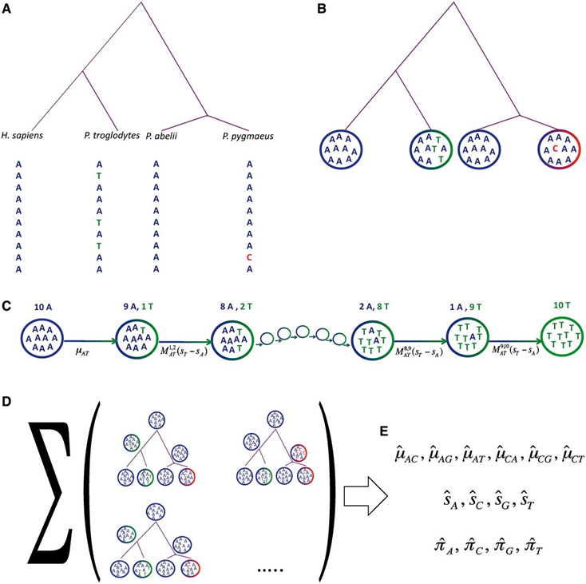
Data from synonymous sites of each of the four species considered are collected.
Each site of each species is associated with a state in PoMo10 according to its allele counts.
Transition probabilities between nodes are calculated according to the PoMo10 rate matrix. For simplification, the figure shows only two alleles, while the full model has four alleles
Following the Felsenstein pruning algorithm (Felsenstein 1981), we sum probabilities over all combinations of states at inner nodes.
The likelihood of all sites is combined, and the process is iterated with different parameter values until we find those that maximize the likelihood. These values (mutation rates, fixation biases, and root nucleotide frequencies) are our final estimates.

Slide 8
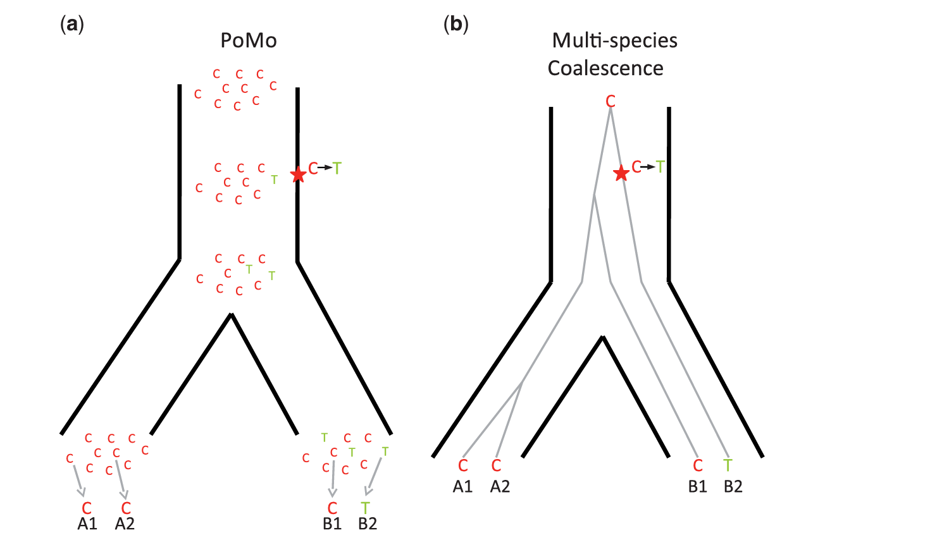
PoMo can account for multiple samples from the same taxon
PoMo allows species to be polymorphic, with two alleles coexisting at a certain frequency.
In PoMo, all sites, even those within the same gene, are modeled as unlinked

Slide 9
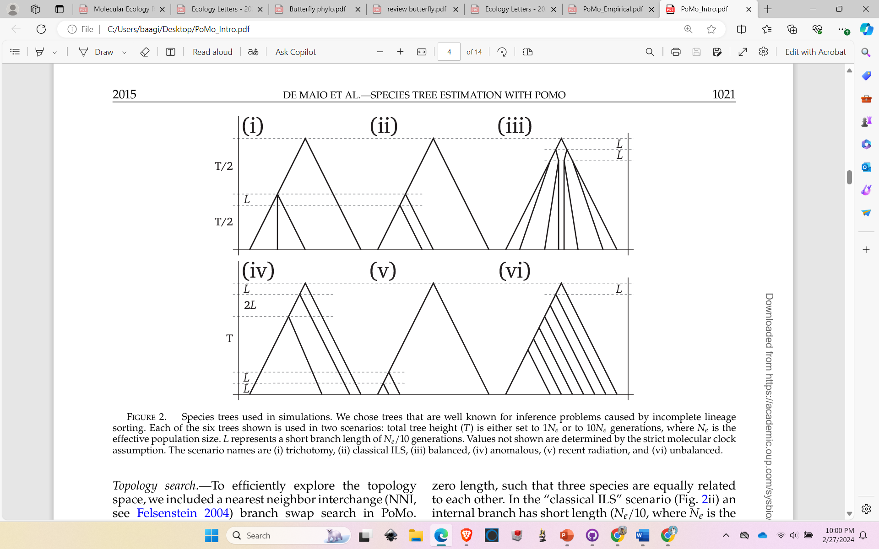
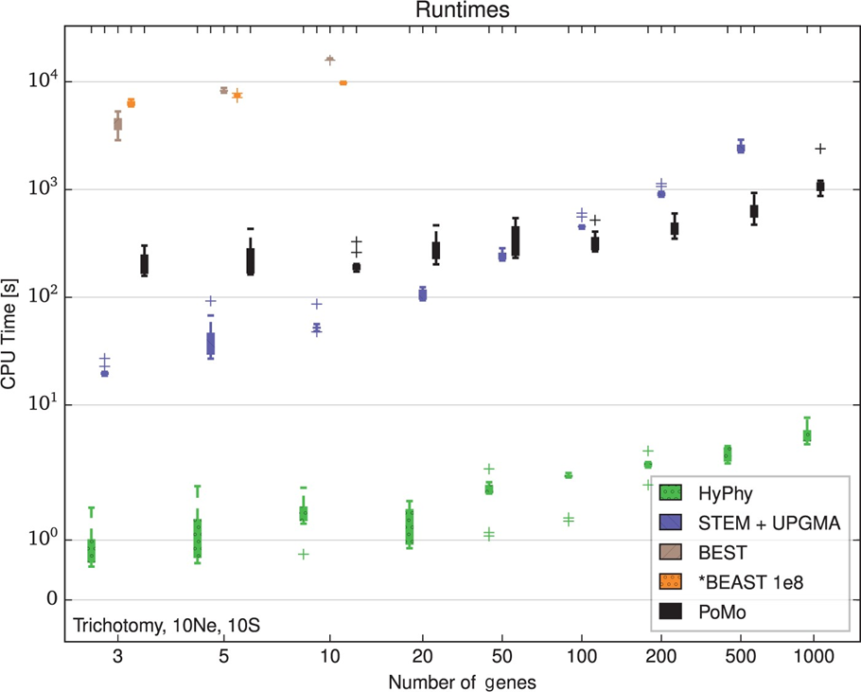
Trichotomy
Classical ILS
Balanced
anomalous
Recent radiation
Unbalanced

Slide 10
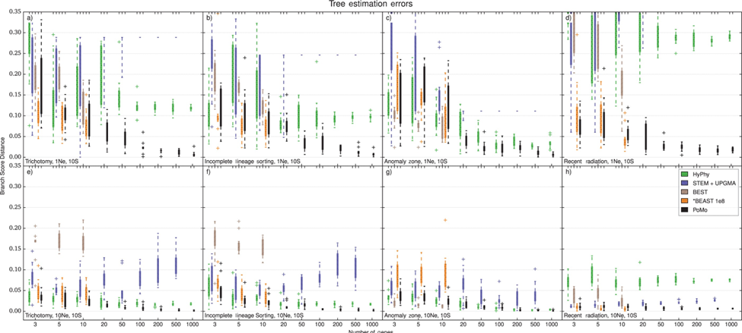

Slide 11
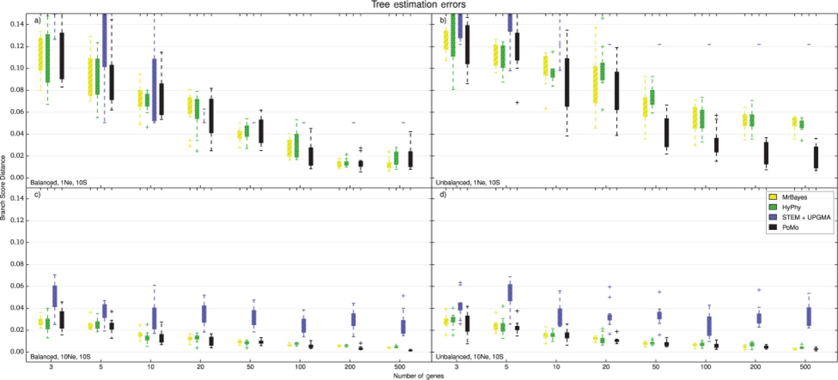

Slide 12
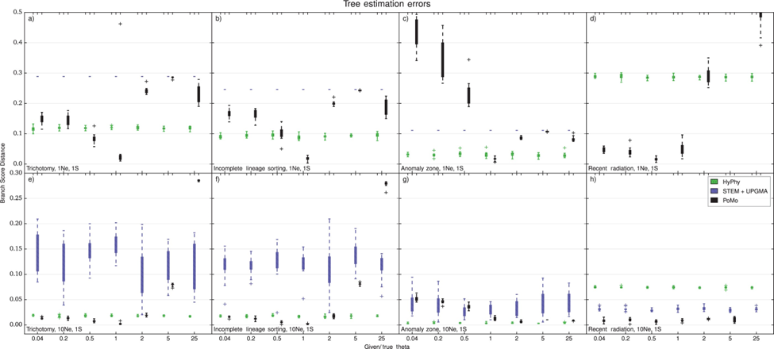
Problematic PoMo?
When within-species variation is not clear (single sample per species) the user needs to input the correct ϴ value (degree of within species variability)

Slide 13
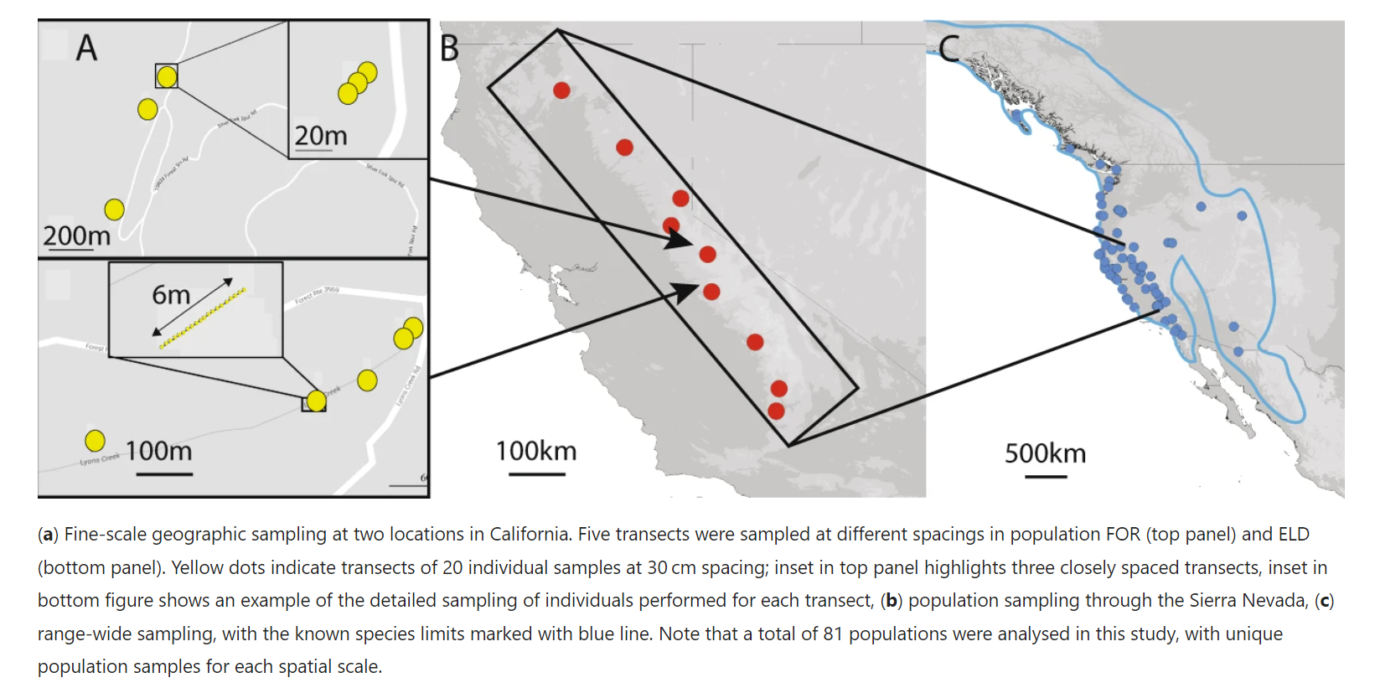
Empirical Study
Looking at genetic variation and population structure in Mimulus guttatus across various spatial scales.

Slide 14
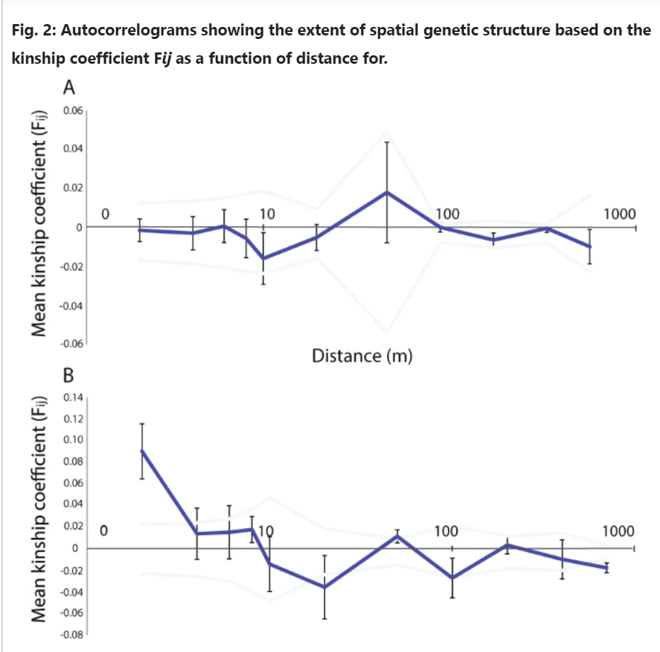
Fine-scale spatial structure
High FIS values and Low SGS(spatial genetic structure)
Dispersal through clonal spread and self fertilization

Slide 15
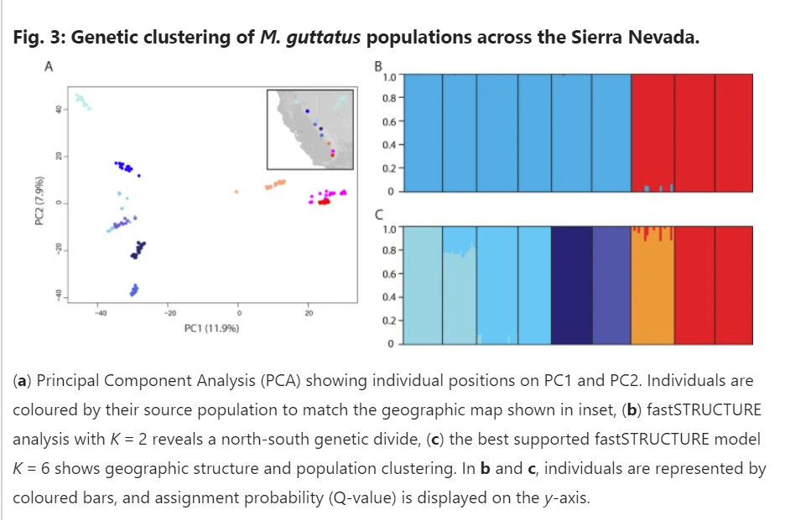
Population-level differentiation
High genetic diversity with a mean per site π of 1.6%, and high population structure with a mean pairwise FST of 0.327

Slide 16
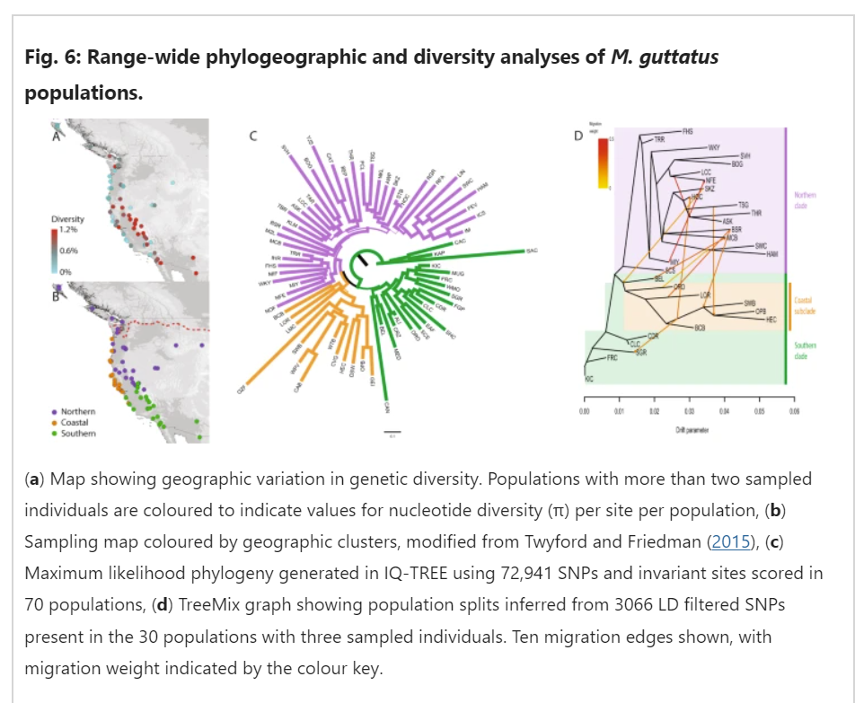
Range-wide diversity
At K=3,
Spatial models distinguished coastal, northern and southern genetic clusters but with major admixture.
PoMo resolved a well-supported tree topology with genetic clusters of southern, coastal and northern populations, while also revealing previously uncharacterized geographic substructure within clades

